Slide 1
Exploring the Determinants of Physician Satisfaction: A Multifaceted Analysis of Compensation, Workload, Lifestyle Autonomy, and Infection Risk across Medical Specialty
Diyar S. Ahmed
Northwood University USA
ahmedds14@northwood.edu

Slide 2
Objective
- Introduction
- Literature review
- Expedite how the range of values are set and in what percentile.
- Examine each factor according to descriptive analytics.
- Determine the correlation between satisfaction and each factor.
- Determine key factors influencing physician satisfaction.
- Provide evidence-based suggestions for elimination.
- Contribute to the further understanding of Multicollinearity .
- Develop a predictive model for physician satisfaction
- Determine disparities and areas for improvement and guide future research by examining the errors.
- Conclusion

Slide 3
Introduction
This research investigates physician satisfaction factors by specialty, such as yearly earnings, workload, lifestyle control, hourly income, and risk of infection.
Analytical methods such as regression and correlation analysis using packages such as Jamovi, Minitab, and Excel
It prescribes evidence-based policy change aimed at increasing job satisfaction, quality of care, and workforce sustainability.
The study compares the most and least satisfying specialties to ascertain the influence of pay arrangements on career satisfaction.

Slide 4
Literature review
Calwell, H. G. (1942). Working for a Salary. British Medical Journal
Gosden, T., Pedersen, L., & Torgerson, D. (1999). How should we pay doctors? A systematic review of salary payments and their effect on doctor behaviour.
Joyce, C. M., Schurer, S., Scott, A., Humphreys, J., & Kalb, G. (2011). Australian doctors’ satisfaction with their work: results from the MABEL longitudinal survey of doctors.
Konrad, T. R. (2015). Measures, methods, and models of doctor satisfaction: future research challenges. Professions and Professionalism

Slide 5
Variables
Specialty: The medical doctor field
Overall Satisfaction in %: The percent that the doctor is satisfied with their work
Lifestyle : define how the medical doctor operating there work in which controllable mean1 and uncontrollable mean 0
Salay per year: how much does a medical doctor make in a year in thousand
Average Work Hours/Week: hours working in a week
Years of Graduate Medical Education: Years of studying to become a medical specialist
Workload Manageability %: the percent that his field could have a good result outcome
Risk %: The percentage of medical doctor get infection in his filed

Slide 6
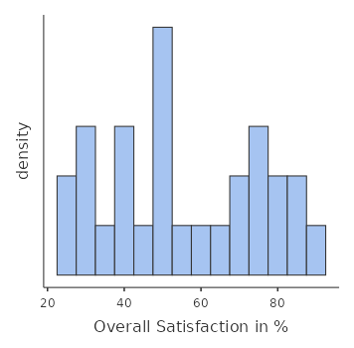
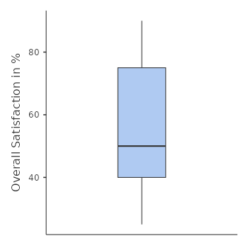
Key Factors Influencing Physician Satisfaction.
Statistics
Variable | N | Minimum | Q1 | Median | Q3 | Maximum
Overall Satisfaction (%) | 28 | 25 | 40 | 50 | 75 | 90
The 28 respondents' Overall Satisfaction (%) has a median of 50%, with a range of 25% (minimum) to 90% (maximum). The interquartile range (IQR) of 40% to 75% indicates moderate satisfaction, but variability suggests differences among the respondents.

Slide 7
Examine each factor according to descriptive analytics.
Variable | N | Mean | SE Mean | StDev | Minimum | Q1 | Median | Q3 | Maximum
Overall Satisfaction in % | 28 | 55.5357 | 3.8174 | 20.1999 | 25 | 40 | 50 | 75 | 90
Salay per year | 28 | 352.893 | 16.815 | 88.9754 | 239 | 279 | 341.5 | 424.2 | 554
Average Work Hours/Week | 28 | 50.8786 | 0.7255 | 3.83892 | 44.2 | 47.4 | 52 | 53.25 | 57.7
Years of Graduate Medical Education | 28 | 4.5 | 0.1744 | 0.92296 | 3 | 4 | 5 | 5 | 6
Workload Manageability % | 28 | 51.4286 | 3.9328 | 20.8103 | 20 | 31.25 | 52.5 | 70 | 85
Infection Risk in % | 28 | 35 | 3.5168 | 18.6090 | 10 | 20 | 32.5 | 48.75 | 80

Slide 8
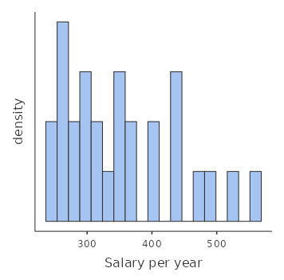
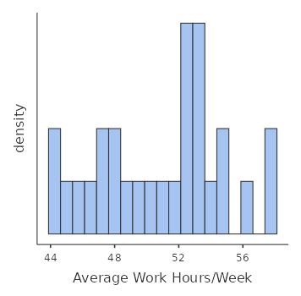
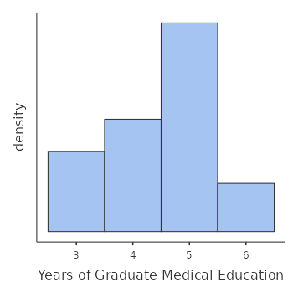
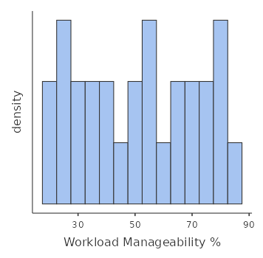
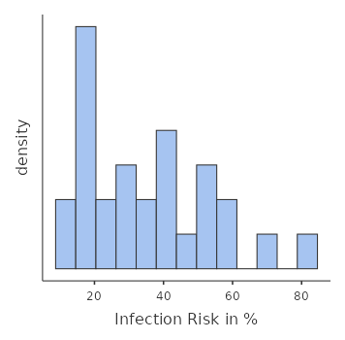

Slide 9
Determine the correlation between satisfaction and each factor.
 | Overall Satisfaction in % | Salay per year | Average Work Hours/Week | Years of Graduate Medical Education | Workload Manageability %
Salay per year | 0.311
Average Work Hours/Week | -0.218 | 0.204
Years of Graduate Medical Education | -0.164 | 0.303 | -0.066
Workload Manageability % | 0.811 | 0.147 | -0.094 | 0.010
Infection Risk in % | -0.419 | -0.176 | 0.072 | 0.065 | -0.397

Slide 10
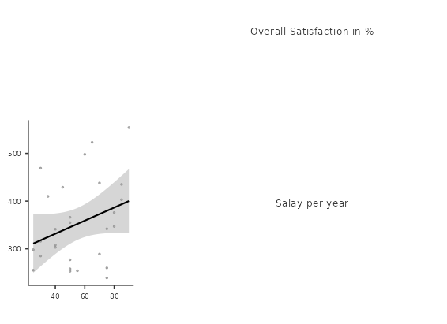
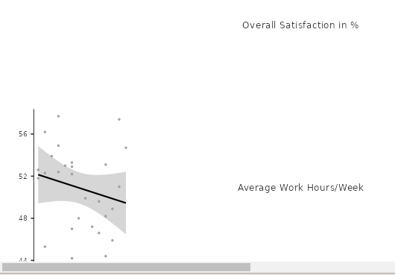
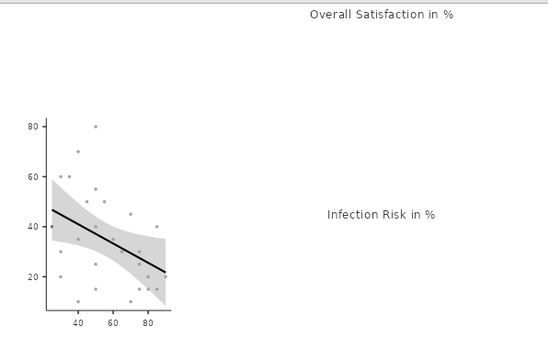
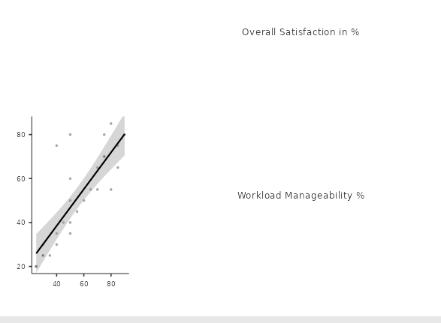

Slide 11
Determine key factors influencing physician satisfaction.
Model Fit Measures
Model | R | RÂ² | Adjusted RÂ²
1 | 0.900 | 0.81 | 0.756
Note. Models estimated using sample size of N=28
The multiple regression model explains 81% of satisfaction variability (R² = 0.81), indicating a good fit.
The model confirms that all these factors collectively have a strong impact on physician satisfaction and as such is very critical for the study.

Slide 12
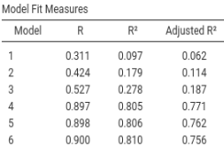
Determine key factors influencing physician satisfaction.
Salary per year
Average Work Hours/Week
Years of Graduate Medical Education
Workload Manageability %
Infection Risk in %
Lifestyle

Slide 13
Provide evidence-based suggestions for elimination
The study uses null hypotheses (H₀) to establish whether independent variables (e.g., salary, workload) are not significantly related to physician satisfaction.
Key Predictors: Compensation, work schedule, education, and workload accessibility are significant predictors of satisfaction.
Satisfaction=83.03+(0.0716×Salary) −(1.26×Work Hours) −(6.15×Years of Education) +(0.685×Workload Manageability)
Model Coefficients - Overall Satisfaction in %
Predictor | Estimate | SE | t | p
Intercept | 88.836 | 29.938 | 2.967 | 0.007
Lifestyle:
Uncontrollable Controllable | -2.928 | 4.575 | -0.640 | 0.529
Salary per year | 0.072 | 0.025 | 2.893 | 0.009
Average Work Hours/Week | -1.261 | 0.526 | -2.397 | 0.026
Years of Graduate Medical Education | -6.147 | 2.232 | -2.754 | 0.012
Workload Manageability % | 0.685 | 0.107 | 6.384 | <.001
Infection Risk in % | -0.020 | 0.118 | -0.173 | 0.864

Slide 14
Contribute to the further understanding of Multicollinearity
Term | VIF
Constant
Salay per year | 1.31
Average Work Hours/Week | 1.10
Years of Graduate Medical Educa | 1.15
Workload Manageability % | 1.35
Infection Risk in % | 1.31
Lifestyle
Uncontrollable | 1.44
Interpretation:
Since all VIF values for the independent variables are below 2, there is no significant multicollinearity in the model. This means all variables are independent enough to be retained in the regression model.

Slide 15
Develop a predictive model for physician satisfaction
Term
Constant
Salay per year
Average Work Hours/Week
Years of Graduate Medical Educa
Workload Manageability %
Infection Risk in %
Lifestyle
Uncontrollable
AIC
250
249
247
212
214
216
Key Insight: Workload manageability is the strongest model, leading to greatest AIC reduction.
Insignificant Variables: Lifestyle and risk of infection don't contribute to the model and can be excluded.

Slide 16
Determine disparities and areas for improvement and guide future research by examining the errors.
Sample Size and Representativeness
Multicollinearity
Omitted Variable Bias
P-Value Interpretation
Model Overfitting
Data Variability

Slide 17
Conclusion
Maximizing workload, salary, and control and minimizing infection risk and work hours can strongly improve physician satisfaction
all these factors collectively have a strong impact on physician satisfaction
Compensation, work schedule, education, and workload accessibility are significant , while
There is no significant multicollinearity in the model

Slide 18
References
Jena, A. B., Olenski, A. R., & Blumenthal, D. M. (2016). Sex differences in physician salary in US public medical schools. JAMA internal medicine, 176(9), 1294-1304.
Calwell, H. G. (1942). Working for a Salary. British Medical Journal, 2(4267), 464.
Gosden, T., Pedersen, L., & Torgerson, D. (1999). How should we pay doctors? A systematic review of salary payments and their effect on doctor behaviour. Qjm, 92(1), 47-55.
Joyce, C. M., Schurer, S., Scott, A., Humphreys, J., & Kalb, G. (2011). Australian doctors’ satisfaction with their work: results from the MABEL longitudinal survey of doctors. Medical Journal of Australia, 194(1), 30-33.
Konrad, T. R. (2015). Measures, methods, and models of doctor satisfaction: future research challenges. Professions and Professionalism, 5(1).

Slide 19


Slide 20

Thank you

